Slide 1
New Age Hiring Model
for the Telstra DevOps world

Slide 2
Presentation agenda
Objective
As-is recruitment model
Proposed/ to-be model
Benefits
The ask

Slide 3
Objective
Hiring model with respect to latest trends (do have any trends) in industry
Unique challenges for this project
Accelerated onboarding (~4 weeks)
Assured recruitment of well-rounded profile (communication skills/ aptitude + attitude)
Preparedness for real-life, production-grade problems and candidate readiness from Day 1

Slide 4
Proposed Hiring Model – Process Flow (ENT ,SPE)
List of tasks approved by Technical Panel
Module1
Module2
Shortlisted candidate
Candidate introduced to the team
Module3
Candidate given tasks to solve – time-boxed
Technical panel evaluate the solution
Candidates interact with team over coffee/lunch
Larger panel evaluate on technical and socializing skill
Candidates grouped based on module/application requirement
DTC
Task1
Task2
Task 3
::
::
How?

Slide 5
As is recruitment model

Slide 6
Proposed recruitment model for ENT/ INT profiles
Requester
Capture requirement
Create minimum eligible qualifications for the position
HR
Operationalize systems
Pre-screen candidates using an online assessment and shortlist 15 resumes
Coordinate with panel for evaluation date/s
Pursue candidate
Receive panel recommendation and pursue candidates
Panel
Prepare problem bank
Prepare/ Shortlist production-grade problems and question bank for online assessment
Publish on portal for ready reference
Introduce and assign problem
Assign the same production-grade coding problems to candidates and give 30-60 minutes to solve
Candidate activity is monitored by panel
Evaluate candidate
Evaluate based on effectiveness, elegance, creativity and readability of candidate’s code and quality of feedback in discussion
Candidates
Respond to advertisement
Respond to advertisement and
Arrive for face-to-face panel evaluation on scheduled evaluation date
Solve problem
Deliverables – code, scratchpad notes, list of assumptions
Upon completion, discuss with other candidates and panel about effectiveness of each solution

Slide 7
Proposed recruitment model for SPE/ EXP profiles
Requester
Capture requirement
Create minimum eligible qualifications for the position
Clearly mention deal-breakers
HR
Operationalize systems
Create shortlist of resumes to vet
Coordinate with panel for evaluation date/s
Pursue candidate
Receive panel recommendation and pursue candidate
Panel
Prepare problem bank
Prepare/ Shortlist production-grade problems
Publish on portal for ready reference
Panel has to be a Scrum team, with one position vacant
Introduce and assign problem
Welcome candidate into reserved conference room within delivery center
Explain production-grade problem and seek creative ideas on solution
Evaluate candidate
Evaluate based on quality of ideas, coherence of solution, structure of approach and articulation of solution
Candidate
Respond to advertisement
Respond to advertisement and
Arrive for face-to-face panel evaluation/ Prepare for video interview
Solve problem
Deliverables – Raw ideas, final solution, algorithm if any, list of assumptions, solution presentation
Engage into scrum and arrive at solution

Slide 8
Sample evaluation sheets

Slide 9
Sample problem statements

Slide 10
Dependencies/ Requirements
Panel (Technical/ HR) will have to coordinate their availability to dedicate about 4 hours on a single day for evaluating about 15 candidates
For ENT/ INT process, panel needs to be able to moderate discussion with 15-20 participants
A conference room with 15 internet-enabled computers and scratchpads will need to be provisioned
Application for administering pre-screening questionnaire

Slide 11
Proposed Hiring Model – A Day@DXC
Candidate introduced to the team in the morning
Right set of problems to be solved by candidates (Using Dynamic talent cloud task would be assigned to candidate by Technical panel based on his/her experience and expertise)
Candidate to come with own laptop, or organization arrange desktop/laptop for the purpose
Candidate spends almost a day, interacting with existing team, during coffee/lunch.
Larger Panel or team, reviews the solutions at the end of the day and decides on the candidate based on technical, tool, presentation, analytical, social, communication skills.

Slide 12
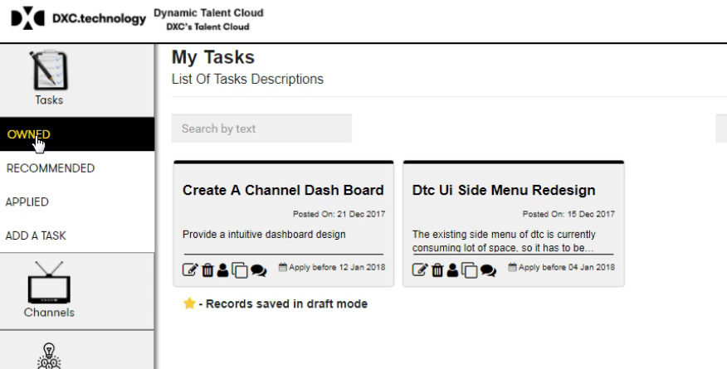
Proposed Hiring Model
Dynamic Talent cloud

Slide 13
Sample problem statements
ENT/ INT level (technical mini-problems)
Create an algorithm for exchanging values of two variables. Optimize for a flash memory environment, where dedicated memory-space for variables is going to be a constraint.
In a menu tree, the sub-menus are issuing a ‘call’ to the main menu instead of ‘return’. What kind of problem will this solution lead to?
SPE/ EXP level (technical case studies)
An application generates logs into a spool-file for every transaction. These are required to be retained for a period of 30 days for diagnostics. Over time, the spool-file size is increasing and needs to be controlled. Propose a few solutions for this, with pros, cons and development effort required for each.
There is disagreement between customer and IT teams. Customer says that there are massive business disruptions and that IT is not doing enough to prevent these. IT contends that they are managing to deliver on their very strict 95%+ application availability and 99.99%+ hardware availability SLAs with great difficulty, and that raising SLAs further cannot be managed with current cost structure. Engage with the customer and IT teams (in the panel) and design an acceptable solution for both, within current constraints.

